Slide 1
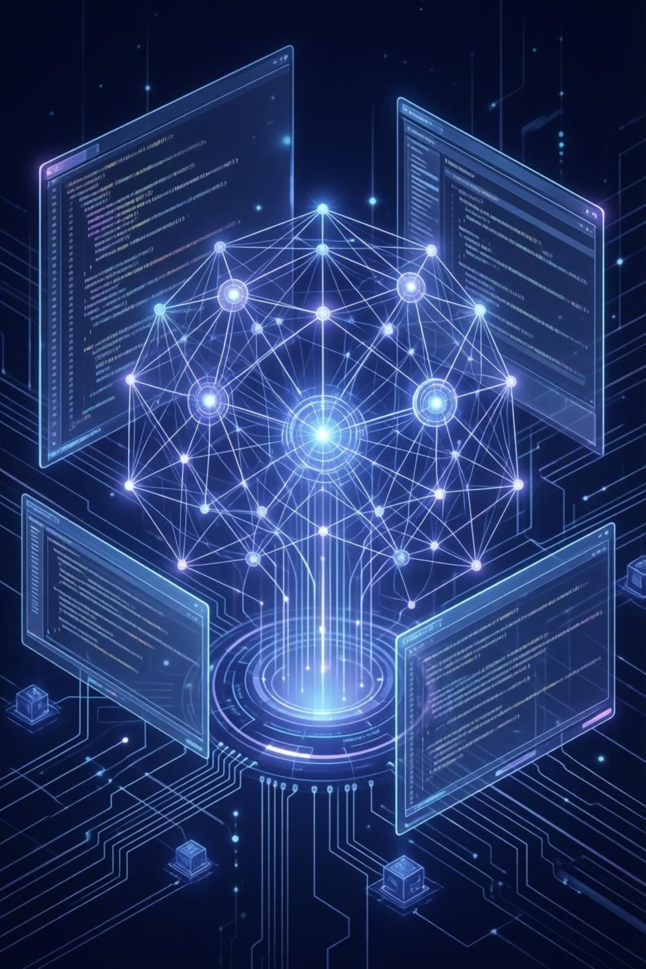
Multi-Agent AI Programming Assistant
Automated Python Code Generation using Agentic AI
This presentation details the development of an innovative Multi-Agent AI Programming Assistant, designed to automate Python code generation using a sophisticated agentic AI approach. The system leverages a powerful tech stack to streamline the development process.
Tech Stack: Python · Streamlit · Phi Framework · Ollama (TinyLlama)

Slide 2
Challenges in Traditional AI Coding Systems
Incomplete or Incorrect Responses
Lack of Structured Development
Single Large Language Model (LLM) outputs often lack the comprehensive accuracy required for robust code.
Absence of a defined software development lifecycle (SDLC) leads to unstructured and inefficient processes.
Manual Debugging and Validation
Absence of Autonomous QC
Developers spend significant time on manual debugging and validation, slowing down progress.
Traditional systems often lack integrated mechanisms for autonomous quality control and verification.

Slide 3

Our Goal: A Multi-Agent Programming Assistant
Our primary objective is to construct a sophisticated Multi-Agent Programming Assistant that can autonomously handle the entire code generation and validation process. This system aims to replicate and enhance a real-world software engineering team's capabilities.
Understand User Requirements
Precisely interpret and analyse user prompts to define programming tasks.
Generate Python Code
Produce functional and efficient Python code based on the interpreted requirements.
Automatically Debug Errors
Identify and resolve logical and syntax errors within the generated code without human intervention.
Review Correctness
Validate the code's accuracy and ensure it meets all specified criteria and functions as intended.
Produce Real-World Use Cases
Generate practical examples to demonstrate the code's functionality and applicability.

Slide 4
Agentic AI Concept
What is Agentic AI?
Agentic AI employs a collaborative framework where multiple autonomous agents, each assigned a specialised role, work synergistically. This structure mirrors the efficiency and specialisation found in a human software engineering team, ensuring a robust and reliable development pipeline.
Analyst
Developer
Debugger
Interprets requirements.
Writes the code.
Identifies and fixes issues.
Reviewer
Product Designer
Ensures quality and correctness.
Shapes the solution.
Modularity
Self-correction
Higher Accuracy
Production-like Workflow

Slide 5
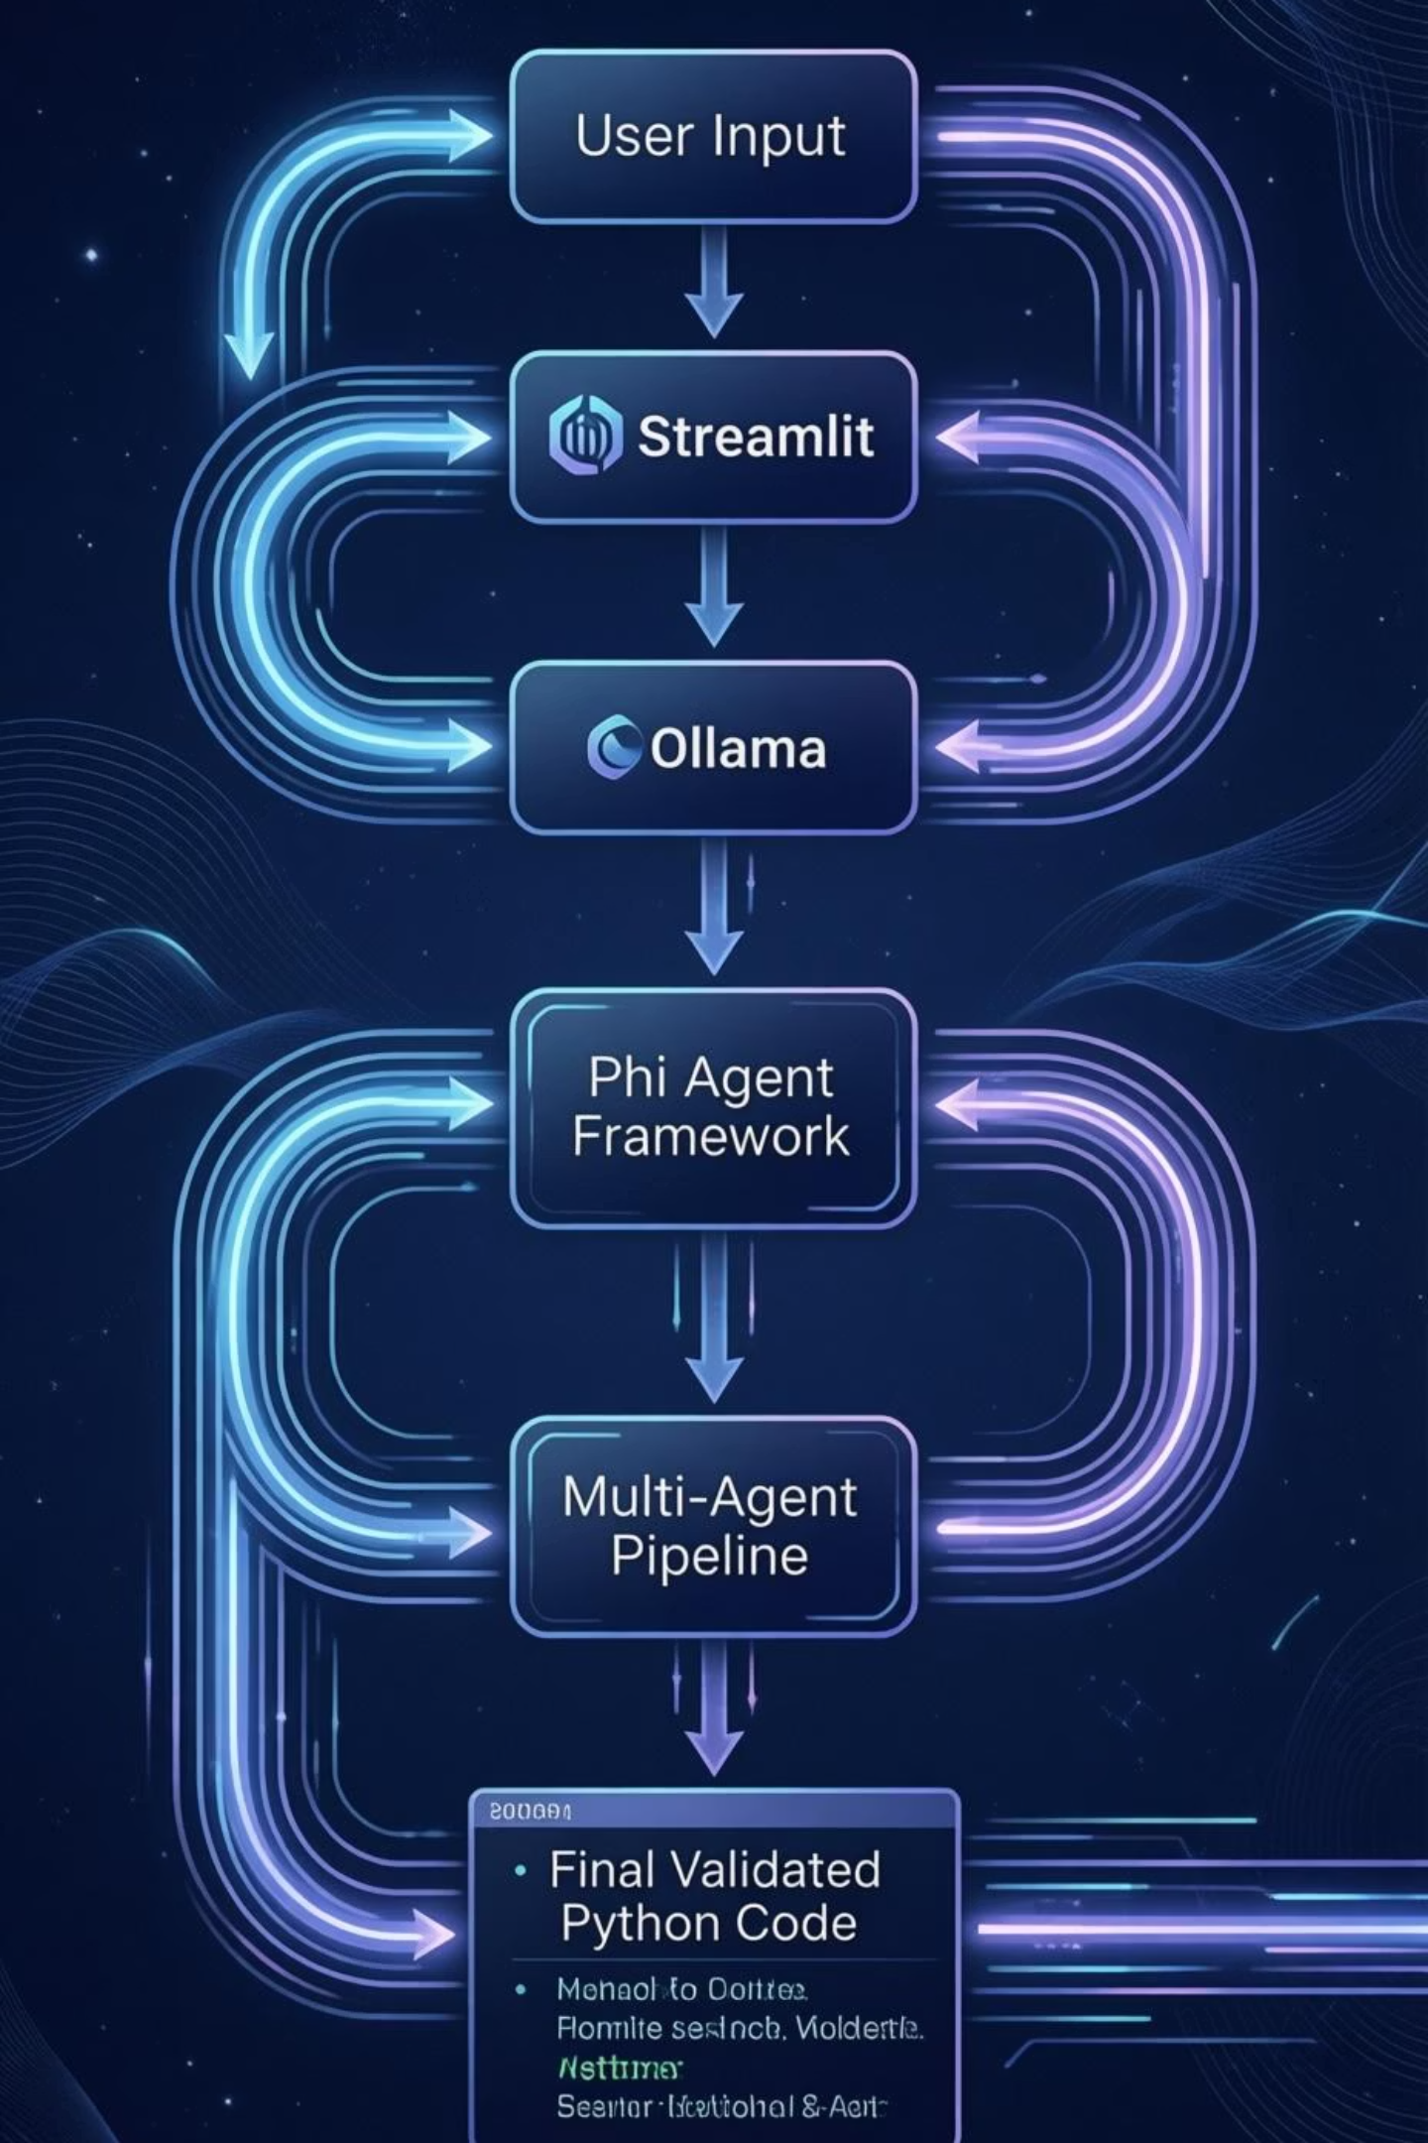
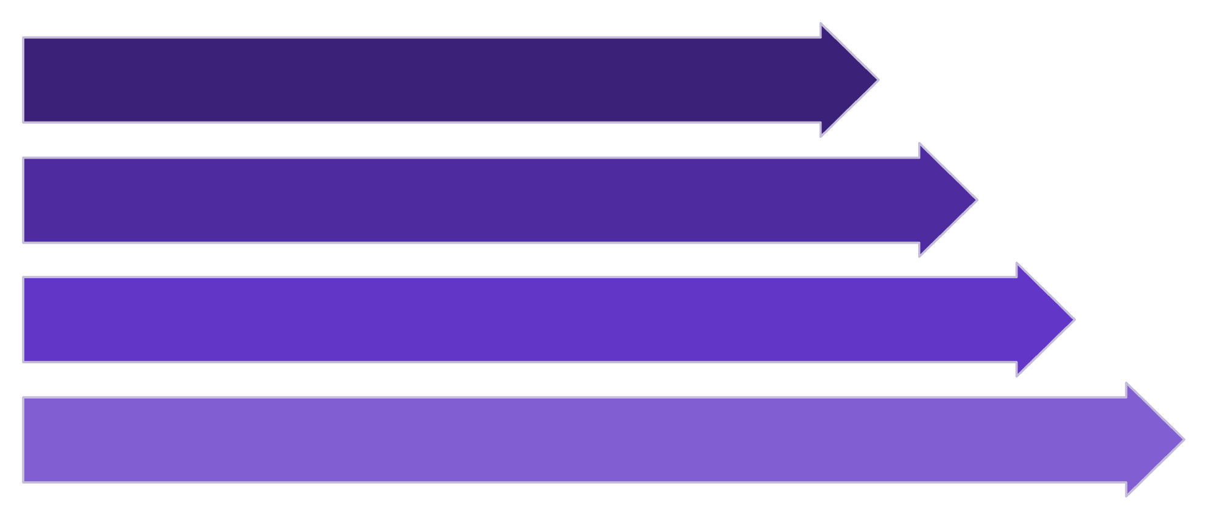
System Architecture
High-Level Flow
User Input
Streamlit Interface
Ollama LLM
Phi Agent
This architecture outlines the journey of a user's request, from initial input through a series of AI-driven stages, culminating in validated Python code. Each component plays a crucial role in processing and refining the output, ensuring a seamless and efficient workflow.

Slide 6
Agent Roles
Implemented Agents
Our Multi-Agent AI Programming Assistant incorporates several key agents, each designed with specific custom instructions to perform a critical function in the code generation and validation process. This specialisation ensures a robust and accurate output.
Explainer Agent
Developer Agent
Debugger Agent
Reviewer Agent
Transforms the problem into a clear, concise bulleted explanation.
Generates the initial Python code structure and logic.
Identifies and rectifies bugs, ensuring code functionality and improving its logic.
Verifies the correctness and adherence to standards, confirming code quality (STATUS: APPROVED).
UseCase Agent
Creates three practical, real-world input-output examples to demonstrate the code's application.

Slide 7
Workflow Execution
End-to-End Pipeline
The entire workflow meticulously replicates a real-world Software Development Lifecycle (SDLC), ensuring that each step from user request to final validated code is handled systematically and efficiently.
01
02
03
User Submits Python Task
Explainer Analyses Problem
Developer Writes Code
04
05
06
Debugger Refines Solution
Reviewer Validates Output
UseCase Agent Adds Examples
07
Final Production-Ready Code Displayed

Slide 8
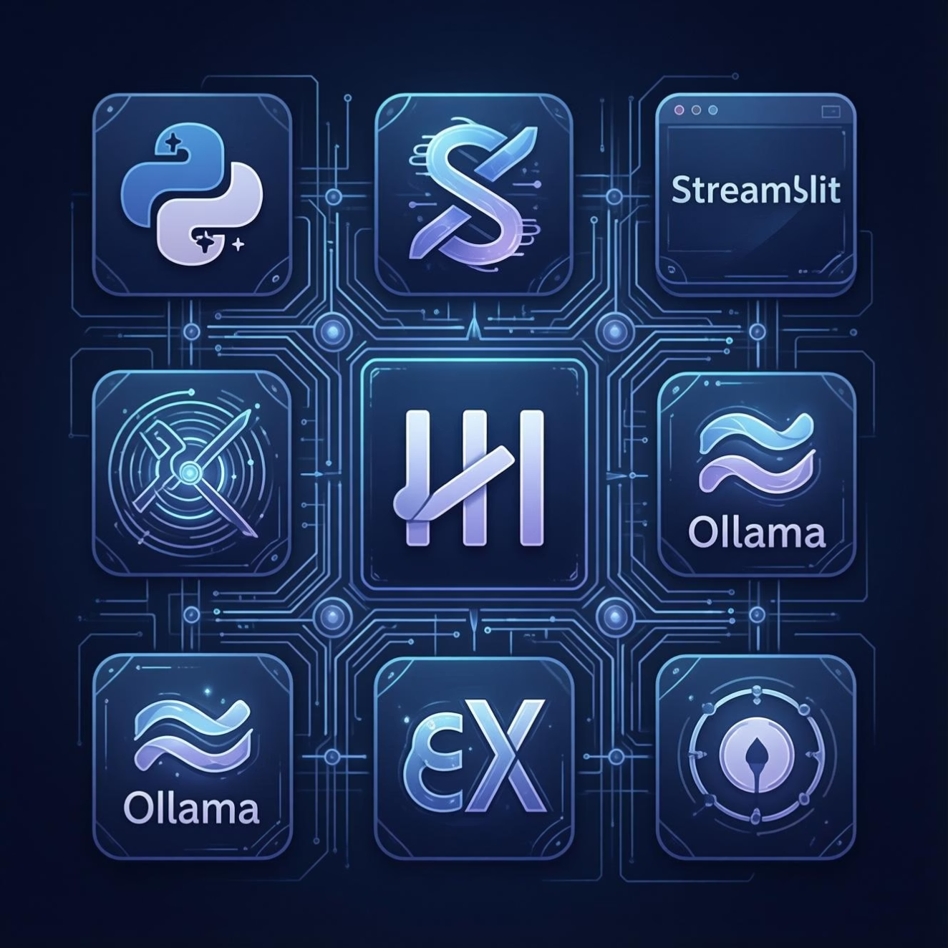
Technology Stack
Core Technologies
The Multi-Agent AI Programming Assistant is built upon a robust and efficient technology stack, combining modern programming languages, UI frameworks, and cutting-edge AI tools to deliver seamless automation.
Python 3.11: The primary programming language for development.
Streamlit: Utilised for building the intuitive and interactive frontend user interface.
Phi Framework: Serves as the orchestration layer for managing and coordinating AI agents.
Ollama: Provides the local runtime environment for the Large Language Models.
TinyLlama: The specific language model chosen for efficient and effective local AI processing.
Regex + Exception Handling: Implemented as essential safety mechanisms for error prevention and robust code generation.

Slide 9
Key Outcomes
Achievements
Autonomous Coding Workflow
Built-in Debugging & Validation
Modular Agent Architecture
Offline LLM Execution
Scalable Design
Real Engineering Simulation
Applications
AI Coding Assistants
Developer Productivity Tools
Educational Tutors
Enterprise Automation

Slide 10
Conclusion
We have successfully implemented a Multi-Agent Agentic AI system that automates the entire coding lifecycle, from initial requirement analysis to generating production-ready Python code with built-in debugging and validation. This innovative approach significantly streamlines the development process.
Future Enhancements
RAG Integration
Unit Testing Agent
Docker Deployment
Cloud Hosting
Memory-Enabled Agents
CI/CD Automation

